Slide 1


Department of Computer Science and Engineering
GE19612 Professional Readiness for Innovation, Employability and Entrepreneurship
AI ASSINTANCE CHATBOT FOR MENTAL HEALTH ADVICE
Advaidh C
210701017
Agash G 210701018
Dr.T.Kumaragurubaran
Professor

Slide 2
Abstract
This project presents MindSupport, an innovative chatbot designed to deliver accessible and personalized mental health support. Leveraging advanced natural language processing and machine learning techniques, MindSupport interacts with users to identify mental health concerns such as depression, anxiety, and PTSD. Based on these interactions, the chatbot provides tailored treatment recommendations from a comprehensive database of mental health resources. The system architecture integrates a Python backend with spaCy for natural language processing, a Node.js server for API management, and a React frontend for a user-friendly interface. MindSupport aims to bridge the gap in mental health care accessibility, offering a non-judgmental platform for users to seek help. Future enhancements include improved personalization, multilingual support, teletherapy integration, and real-time professional assistance, positioning MindSupport as a crucial tool in promoting mental well-being.

Slide 3
Existing System
Currently, the landscape of mental health support systems is characterized by traditional methods such as in-person therapy, hotlines, and online forums. While these resources have proven beneficial to many individuals, they come with significant limitations. In-person therapy sessions often require scheduling appointments in advance, are costly, and may carry a social stigma that prevents some individuals from seeking help. Hotlines provide immediate support but are often overwhelmed, leading to long wait times and limited availability. Online forums offer anonymity but lack personalized guidance and may not always provide reliable information. Overall, the existing system fails to adequately address the diverse needs of individuals seeking mental health support, leaving many underserved and without access to timely and effective interventions.

Slide 4
Proposed System
The proposed system aims to overcome the limitations of the existing mental health support system by leveraging chatbot technology to deliver personalized and accessible support to users. The chatbot-based mental health support system will provide users with a convenient and non-judgmental platform to seek help and guidance for their mental well-being. Through natural language processing algorithms, the chatbot will analyze user input to identify specific mental health concerns and provide tailored treatment recommendations and resources. By integrating a comprehensive database of mental health treatments and resources, the chatbot will offer users access to evidence-based interventions and support options tailored to their individual needs.

Slide 5
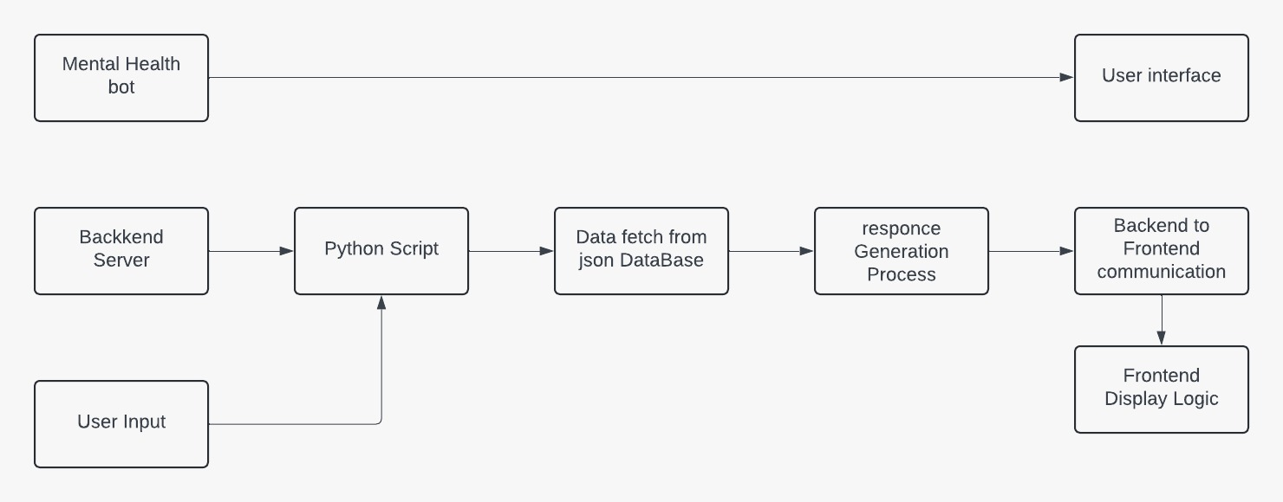
System Architecture

Slide 6
List of Modules
Creation of Dataset
Creating Prediction and Analysis Machine Learning model
Creating API’s to do analysis
User Experience

Slide 7
Functional Description for each modules
Creation of Dataset: Within the project, data extraction involves retrieving relevant information from the JSON database. The dataset likely contains details about various mental health treatments, including their names, descriptions, and possibly associated keywords or tags. This data is structured in JSON format, a lightweight data-interchange format that is easy for both humans and machines to read and write. The JSON format allows for organized storage of treatment information, facilitating efficient retrieval and processing by the Python script.

Slide 8
Functional Description of Module
Creating Prediction and Analysis Machine Learning model: The creation of the machine learning model involves leveraging the spaCy library in Python. This provides pre-trained models and tools for natural language processing (NLP), including tokenization, part-of-speech tagging, and named entity recognition (NER). In this context, the machine learning model is used to analyze user input and identify mental health issues mentioned within the text. By processing the input text through the NLP pipeline the model can accurately identify keywords or phrases indicative of mental health concerns.

Slide 9
Functional Description of Module
Creation of API’s: The API creation process involves utilizing the Express.js framework within the Node.js backend to define REST API endpoints. These endpoints serve as the communication interface between the frontend and backend components of the application. For example, a POST endpoint may be created to receive user input from the frontend, while a corresponding response endpoint may be defined to send treatment recommendations back to the frontend. By defining these endpoints, the API enables seamless interaction between the different modules of the application, facilitating data exchange and processing.

Slide 10
Functional Description of Module
User Experience: This encompasses the overall interaction and satisfaction of users with the application. In this project, the user experience is primarily focused on the frontend interface, which provides a chat-like environment for users to interact with the chatbot. The frontend interface is designed to be intuitive and user-friendly, with clear prompts and feedback to guide users through the conversation process. Overall, the goal is to create an engaging and supportive environment that encourages users to seek help and engage with the mental health resources provided by the chatbot.

Slide 11
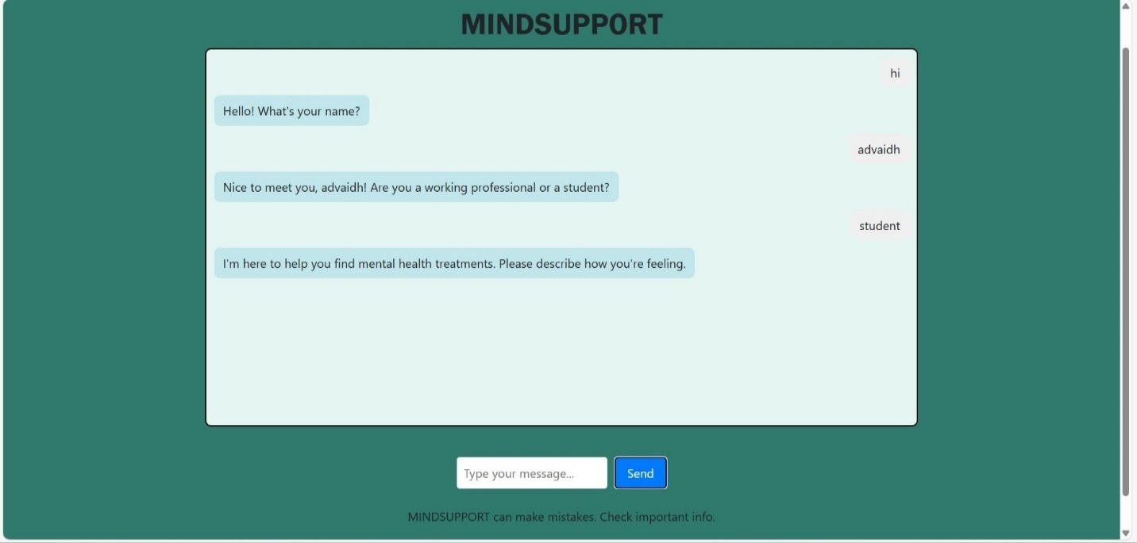
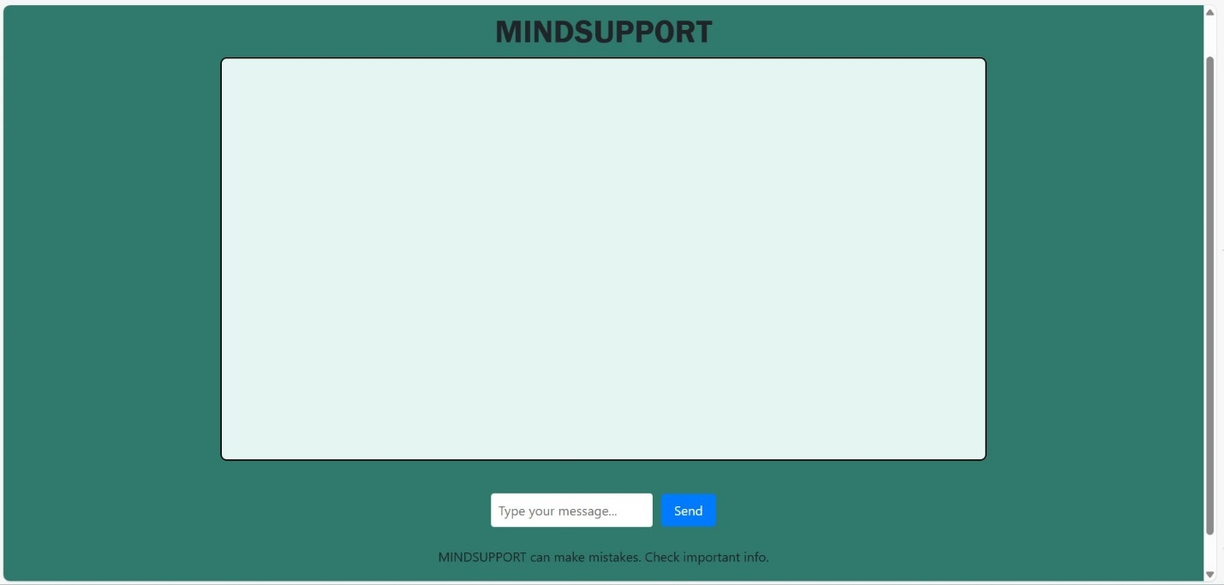
Output
Basic interaction with user
Front interface of the chatbot

Slide 12
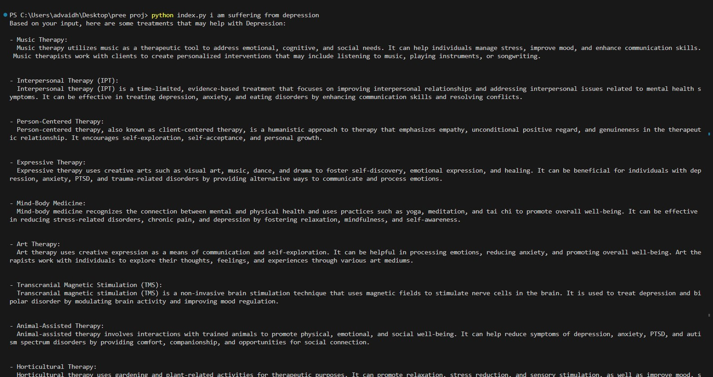
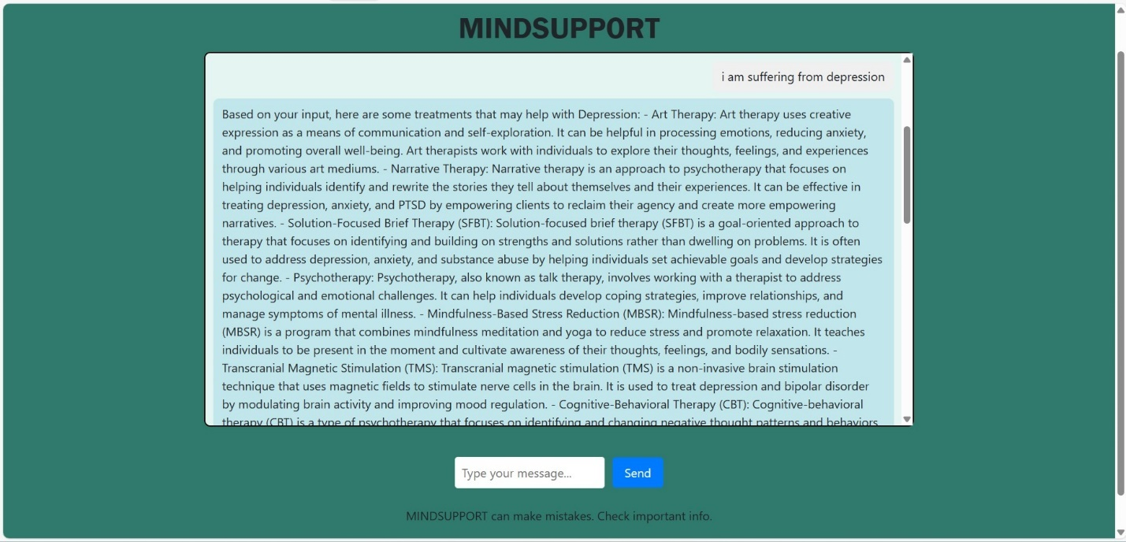
Output
Terminal output for the program
Displaying the treatments for the threat

Slide 13
Conclusion
In conclusion, the development of our mental health chatbot, MindSupport, represents a significant step forward in leveraging technology to address the growing demand for accessible and personalized mental health support. Through careful design and implementation, MindSupport offers users a non-judgmental and convenient platform to seek guidance, resources, and support for their mental well-being. Our project has demonstrated the effectiveness of chatbot-based interventions in delivering mental health support, drawing on insights from existing research and literature in the field. By providing users with personalized treatment recommendations and resources, MindSupport aims to empower individuals to take proactive steps towards managing their mental health and seeking the help they need.

Slide 14
References
1. https://www.trijiog.com 2. https://www.amahahealthy.com 3. https://www.ncbi.nlm.nih.gov/
4. https://www.safetyandquality.gov.au/
5. https://www.covetus.com/blog/
6. https://www.nhsinform.scot/campaigns/health-and-social-care-standards/

Slide 15
Thank You

